Slide 1
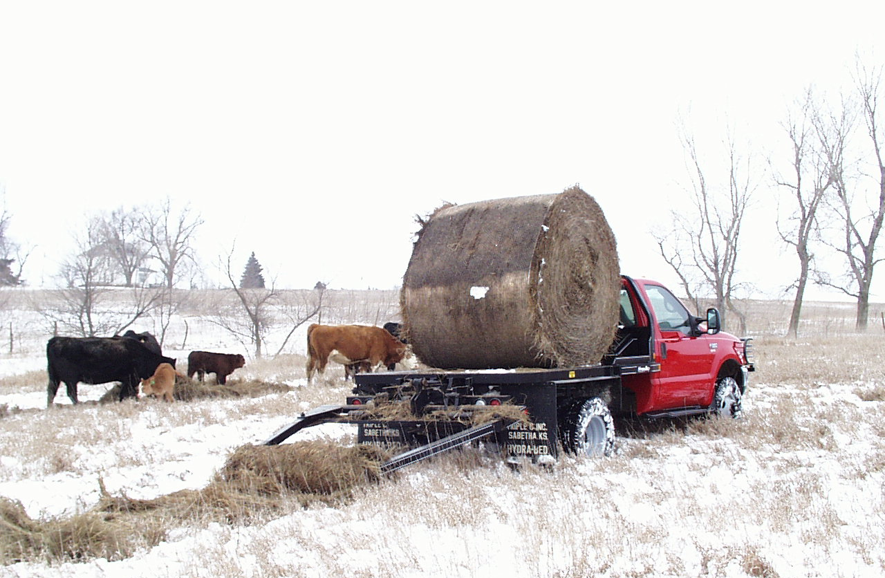
Hydraulic Systems
Our Committment:
Powerful, Simple, Dependable Hydraulics for over 30 years!

Slide 2
Bale Bed Hydraulic Systems: Calculating Cylinder Force
The result will be expressed in pounds. For systems with dual cylinders, multiply by 2. Dividing by 2,000 gives force in Tons.
The mathematic formula for calculating Hydraulic Cylinder Force is very simple:
Inside Area - Shaft Area x System Pressure
-
x
Pounds/Square Inch

Slide 3
Lift Cylinder Effective Area
System Pressure 2,500 PSI
Total Effective Lifting Area 14.1 Square Inches
Total Force Generated 17.6 Tons
Inside Diameter 4-1/2”
Shaft Diameter 1-1/2”

Slide 4
Lift Cylinder Effective Area
DewEze®
System Pressure 2,200 PSI
Total Effective Lifting Area 14.1 Square Inches
Total Force Generated 15.9 Tons
Inside Diameter 4-1/2”
Shaft Diameter 1-1/2”

Slide 5
Lift Cylinder Effective Area
Steerman™
System Pressure 2,250 PSI
Total Effective Lifting Area 10.8 Square Inches
Total Force Generated 12.2 Tons
Inside Diameter 4”
Shaft Diameter 1-1/2”

Slide 6
Lift Cylinder Effective Area
Krogmann™
System Pressure 2,500 PSI
Total Effective Lifting Area 10.8 Square Inches
Total Force Generated 13.5 Tons
Inside Diameter 4”
Shaft Diameter 1-1/2”

Slide 7
Lift Cylinder Effective Area
Hoswel™
Total Effective Lifting Area per Cylinder 5.8 Square Inches Times 2 Cylinders = 11.6
System Pressure 2,000 PSI
Total Force Generated 11.6 Tons
Inside Diameter 3”
Shaft Diameter 1-1/4”
Dual Lift Cylinders

Slide 8
Lift Cylinder Effective Area
Besler™
Total Effective Lifting Area per Cylinder 5.8 Square Inches Times 2 Cylinders = 11.6
System Pressure 2,500 PSI
Total Force Generated 14.5 Tons
Inside Diameter 3”
Shaft Diameter 1-1/4”
Dual Lift Cylinders

Slide 9
Lift Cylinder Effective Area
Cannonball™
Total Effective Lifting Area per Cylinder 5.8 Square Inches Times 2 Cylinders = 11.6
System Pressure 2,250 PSI
Total Force Generated 13.1 Tons
Inside Diameter 3”
Shaft Diameter 1-1/4”
Dual Lift Cylinders

Slide 10
Important Background Information
Lift cylinder force calculations were made using industry-standard hydraulic formulas
All cylinder dimensions and system relief pressure values are from product advertising or were provided by representatives of the various companies
Cylinder force values are compared in the next table
The final table compares estimated lift capacities based on the calculated cylinder force values
Every effort has been made to provide accurate, unbiased information in these comparisons
We reserve the right to make additions or corrections as additional information becomes available

Slide 11
Bale Bed Hydraulic Systems: Comparing Cylinder Force
17.6 Tons - The Leader
DewEze 15.9 Tons 90% of Hydra Bed
Besler 14.5 Tons 82% of Hydra Bed
Krogmann 13.5 Tons 77% of Hydra Bed
Cannonball 13.1 Tons 74% of Hydra Bed
Steerman 12.2 Tons 69% of Hydra Bed
Hoswel 11.6 Tons 66% of Hydra Bed

Slide 12
Simple Bale Bed Facts:
Fact: Cylinder force (area times pressure) is a key factor in comparing true bale bed lift capacity
Fact: All listed bale beds use similar lift cylinder strokes, ranging from DewEze at 16” to all others at 20”
Fact: All listed bale beds convert that cylinder stroke to a similar bale arm swing radius
Fact: The lift cylinder in a Hydra Bed will produce 17.6 Tons of force at the factory system relief pressure of 2,500 PSI
Fact: That 17.6 Tons of force will lift 3,000# at the spinner bushing of a Series 150 Hydra Bed
Fact: Advertised lift capacities should reflect true lift capacities

Slide 13
Advertised Lift Capacity compared to Calculated Lift Capacity
3,000# 3,000# 0# 0%
Lift Capacity Calculated from Cylinder Force
Advertised Lift Capacity
Estimated Discrepancy
DewEze 2,750# 2,700# -50# -2%
Besler 2,200# 2,460# +260# +11%
Krogmann 2,750# 2,310# -440# -19%
Cannonball 2,850# 2,220# -630# -28%
Steerman 2,850# 2,270# -580# -26%
Hoswel 2,500# 1,980# -520# -26%

Slide 14
